Slide 1

VistA Imaging Innovation 873 Telepathology

Slide 2
Overview
Workflow discussion
Review current and additional capabilities of the solution
Current Status

Slide 3
Current AP Workflow
Case Accessioned
Case added to the VistA Telepathology Worklist
HL7 ORL Message to vendor
Case added to the VistA DICOM Modality Worklist (MWL)
Order Entry/Editing
Case updated on the VistA DICOM Modality Worklist and or ORL to vendor system
“Snapshot” DICOM images are acquired (optional)
Sent to VistA – to be associated with the case
Result Reporting
Report is entered in VistA LAB Roll and Scroll
Entering date completed removes case from DICOM MWL
Electronic Signature entered
Images associated with the case

Slide 4
Proposed AP Workflow (Referral site)
Acquisition/Referral site has whole slide scanner
Referral site needs consulting pathologist resources
Referral site accessions specimen(s) in VistA LAB
VistA sends HL7 ORL message to Vendor system, and to modality worklist
Vendor system creates an internal work-item associated with the accession based off the order message
Telepathology Unread Worklist item is created in VistA
Referral site performs the WSI acquisition for the newly created work-item in the vendor system
Referral site request consultation through the Telepathology Worklist application

Slide 5
Proposed AP Workflow (Consulting site)
The consulting pathologist opens an unread item from the Telepathology Worklist
Opening the work-item launches the WSI viewer to display the images stored in the vendor system for the accession
The consulting pathologist may create snapshots and send them to VistA Imaging from vendor system
The consulting pathologist can access the Preliminary Lab report in VistA at the referring site using Telepathology Worklist aplication.
The consulting pathologist creates a supplementary report in VistA at the referring site. (there is a need to create encounter to record workload at the consulting site)
The referral site pathologist finalizes the report and coding (work-item moves to Read List, work-item is removed from Modality Worklist)
Referring site VistA sends the final report to the vendor system

Slide 6
Capabilities
Current
Basic Telepathology Worklist
HL7 messages sent to vendor system
Acquisition of DICOM “snapshot” images into VistA Imaging
Under development
Enhanced Telepathology Worklist
Telepathology Worklist Configurator
Report Editor, Writer and Coder
Request consultation
Whole Slide Image (WSI) viewing

Slide 7
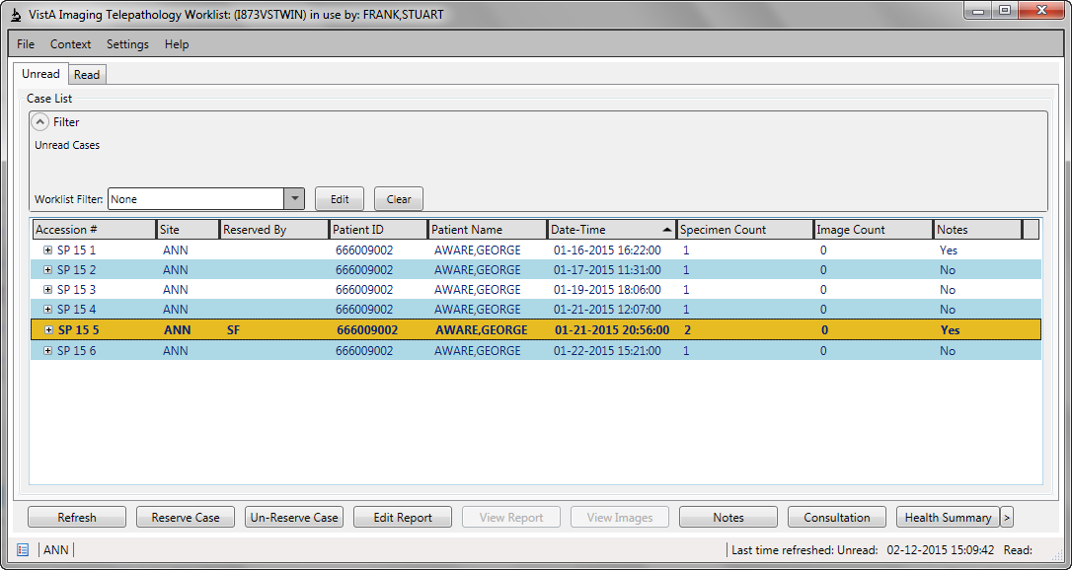
Telepathology Worklist

Slide 8
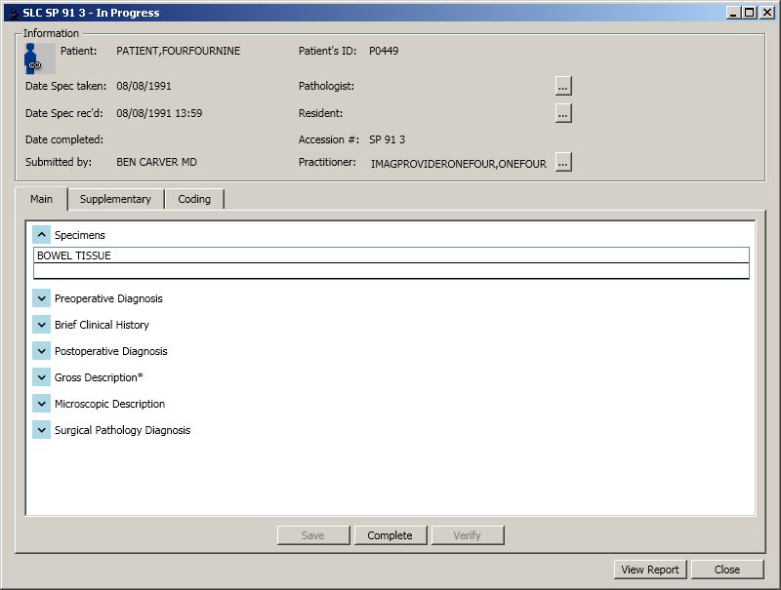
Report Editor/Writer

Slide 9
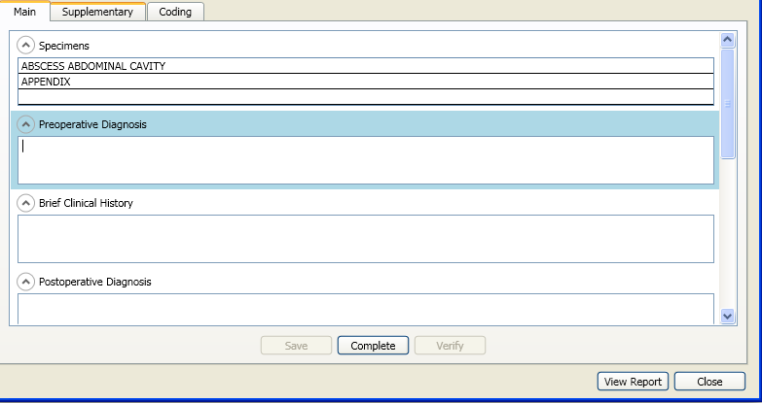
Report Editor/Writer

Slide 10
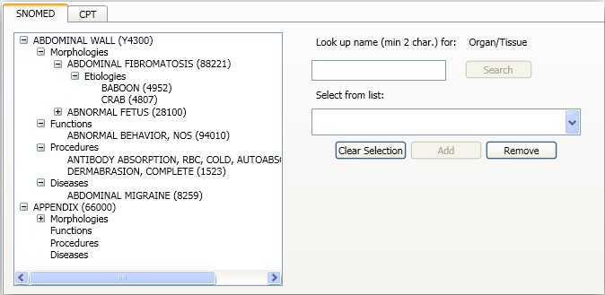
SNOMED and CPT coding

Slide 11
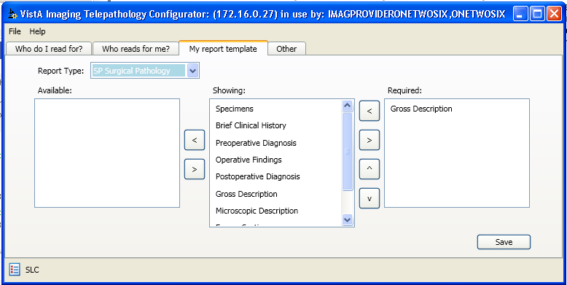
Report Template builder

Slide 12
Questions to SMEs
Is it sufficient to have the report at the referral site only?
Is it sufficient to focus on the referral-consult workflow?
Are all sites getting commercial Telepathology systems, or just scanners?

Slide 13
Questions?

